Slide 1
Exception Handling
by
Ibtisam Mogul

Slide 2
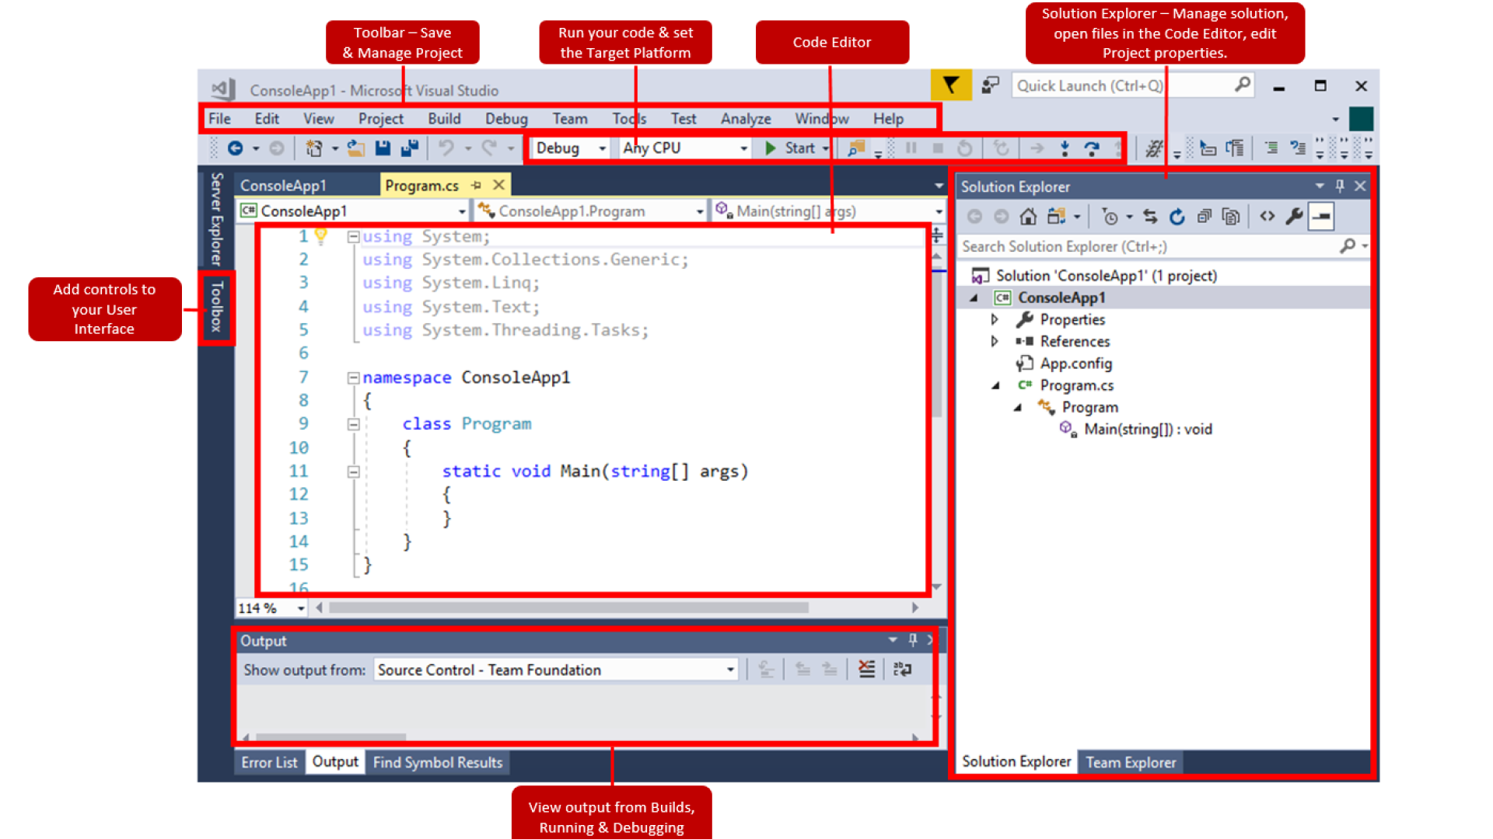
Notes:
https://www.thorlabs.com/Software/Motion%20Control/KINESIS/Kinesis%20with%20C%20Quick%20Start%20Guide.pdf

Slide 3
What You Will Learn
Use
try, throw, catch
to
watch for indicate exceptions handle
How to process exceptions and failures.

Slide 4
Contents
Errors
Types of Errors
Exception
Exception Handling
Try
Catch
Finally
Example
Practice

Slide 5
Error
Error is an illegal operation performed by the user which results in abnormal working of the program. (Bhatia, n.d.)
Categories of errors:
Compile Time
Run Time
Bhatia K. (n.d.) Errors in C/C++. [Online] Available from: https://www.geeksforgeeks.org/errors-in-cc/. [Accessed 12 November 2018].

Slide 6
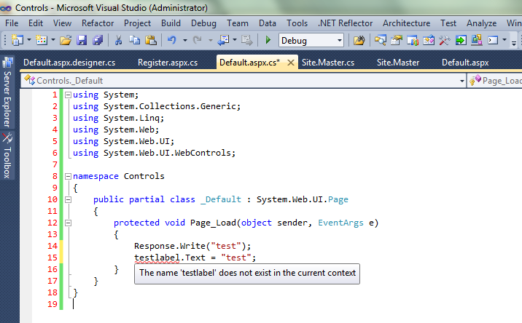
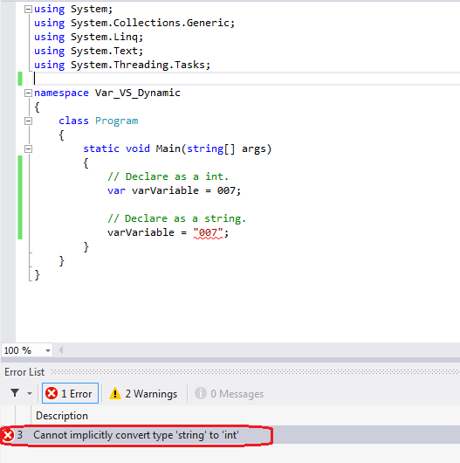
Types of Errors
Build/Compile Time Errors
Syntax errors arise because the rules of the language have not been followed.
They are detected by the compiler.
(Missing semicolons, brackets,
double quotes in strings,
undeclared variables,
incompatible types)
Notes:
https://www.ajaymatharu.com/the-name-does-not-exists-in-the-current-context-asp-net/
http://www.coder007.com/2015/10/var-vs-dynamic-keywords-in-c.html

Slide 7
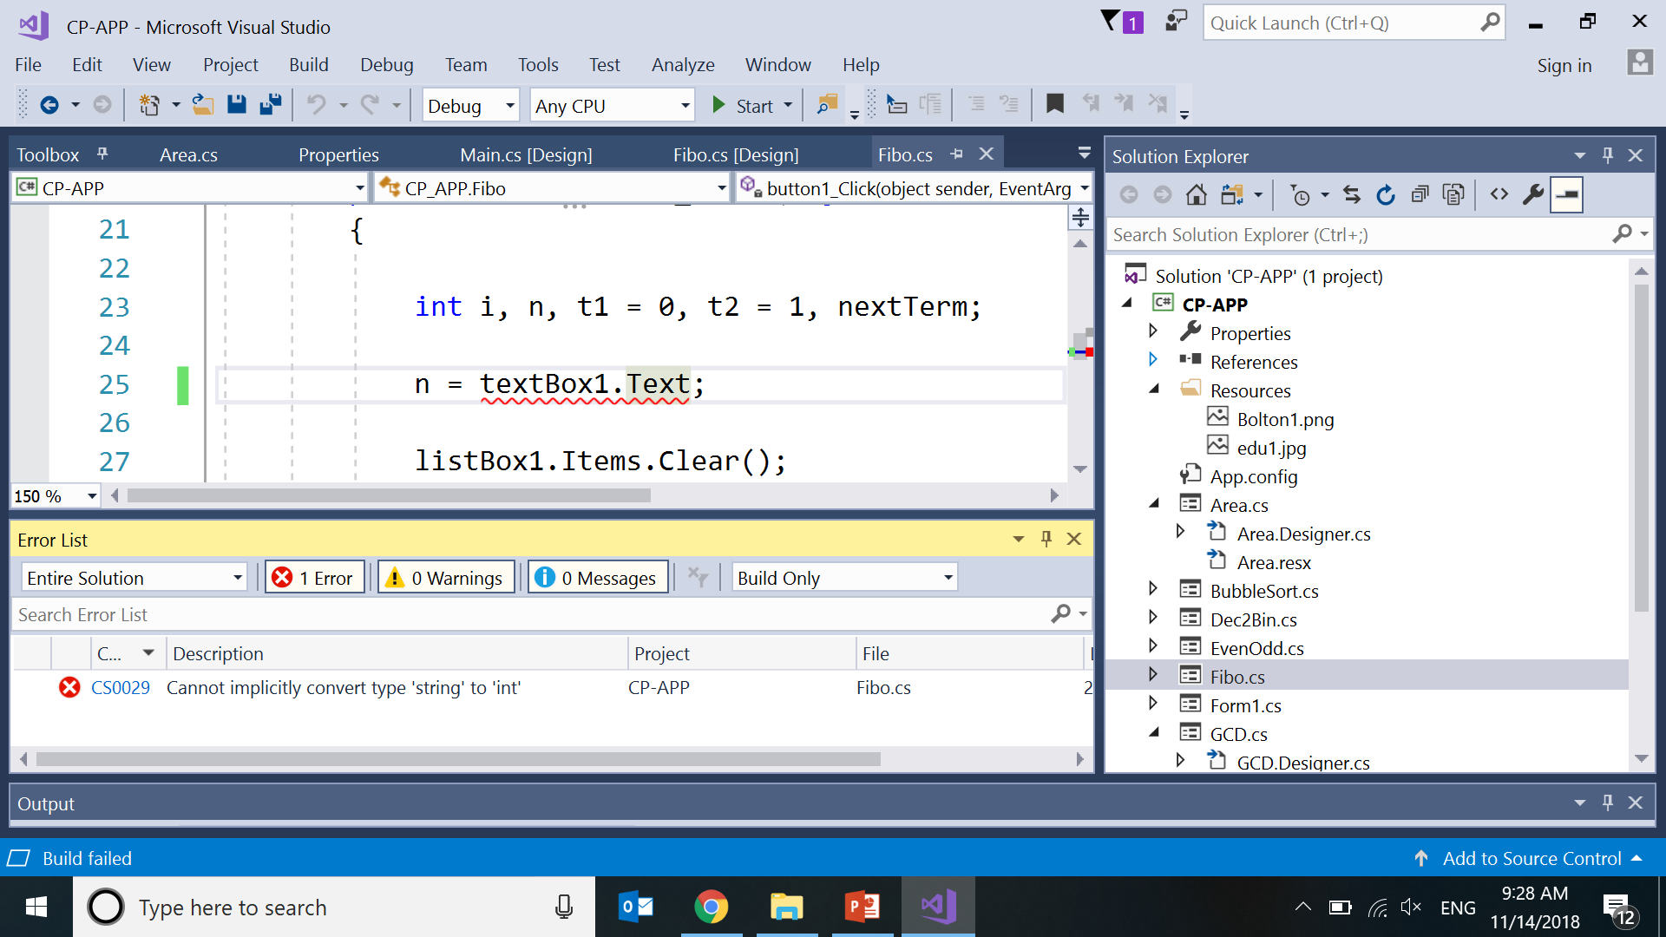
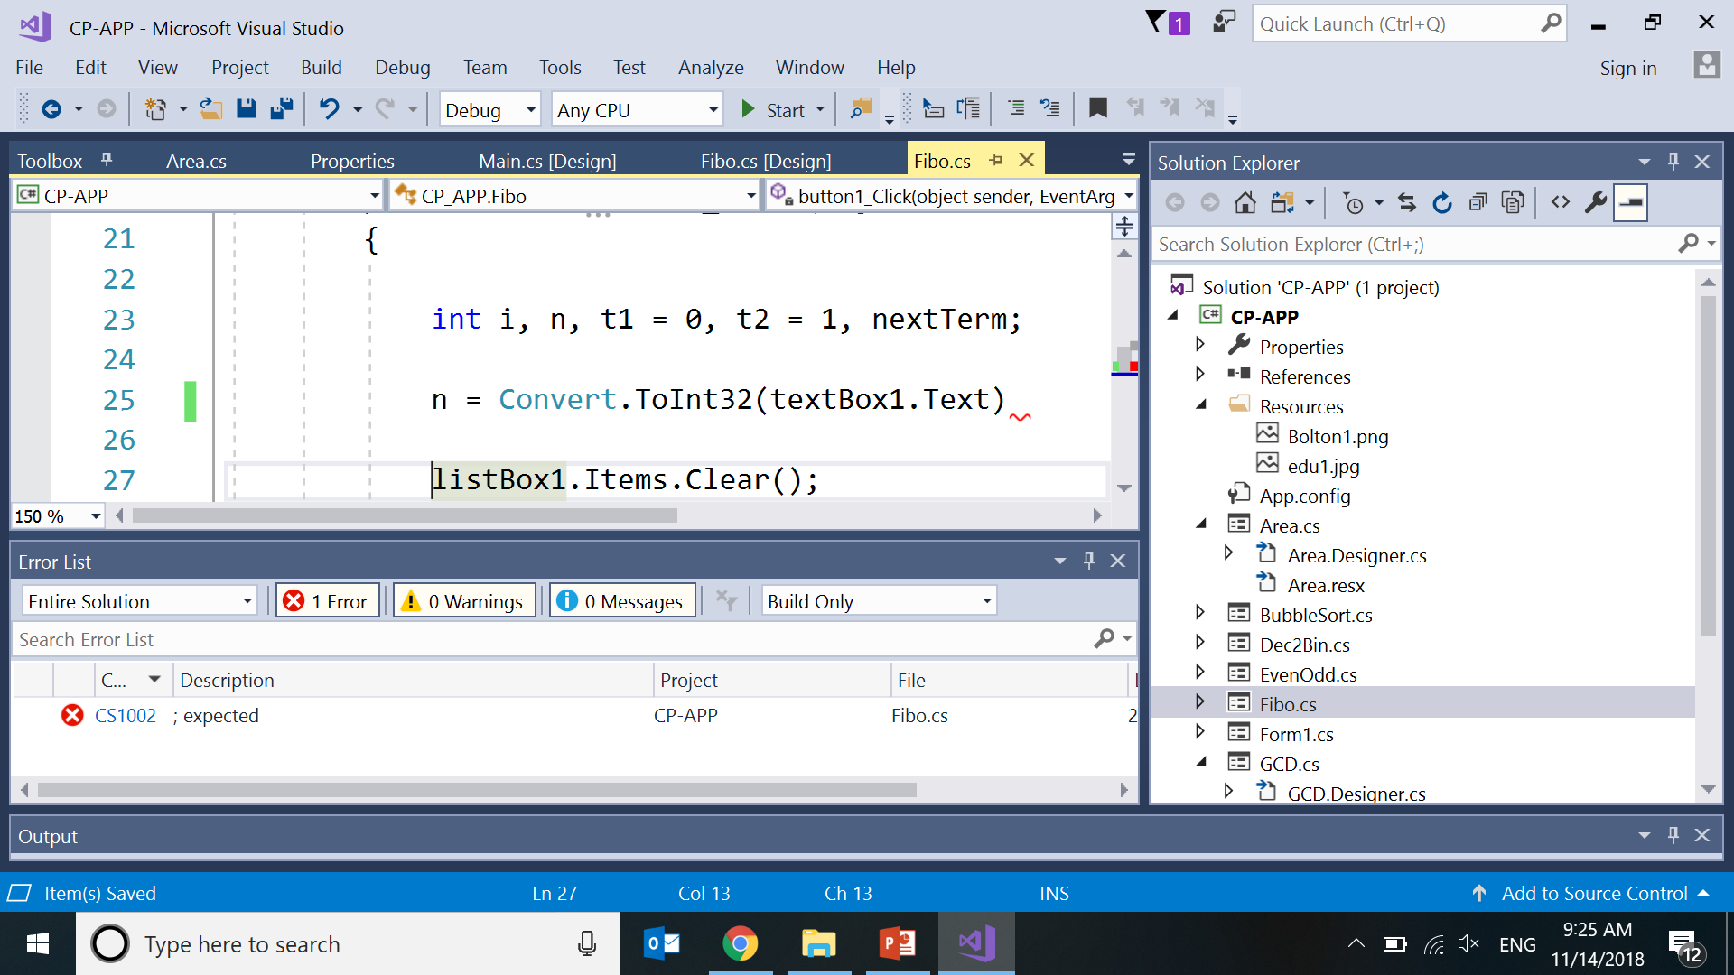
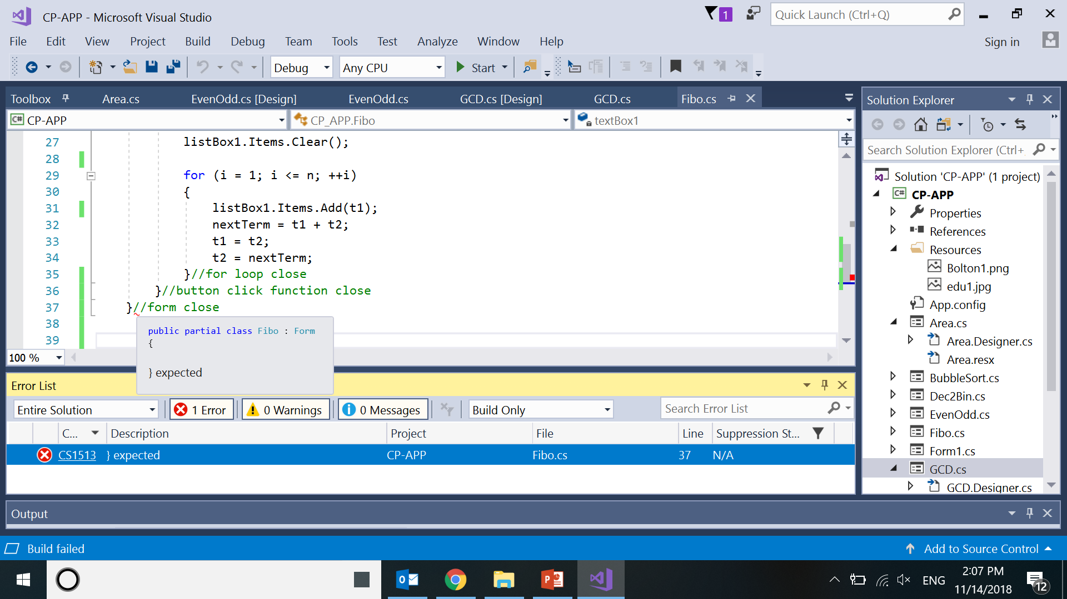
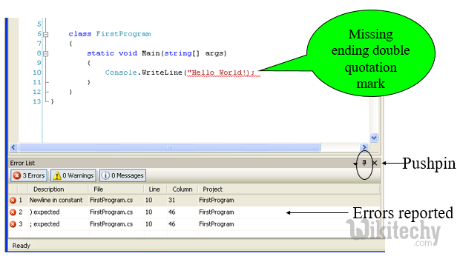
Types of Errors
Build/Compile Time Errors
(Missing semicolons, brackets, double quotes in strings,
undeclared variables, incompatible types)

Slide 8
Types of Errors
B. Runtime errors
Runtime errors occur while the program is running if the environment detects an operation that is impossible to carry out.
(Divide by 0,
passing different datatype parameters,
converting invalid string to number.)

Slide 9
Function to divide 2 numbers
private void button1_Click(object sender, EventArgs e)
{
double result;
double no1 = double.Parse(textBox1.Text);
double no2 = double.Parse(textBox2.Text);
result = no1 / no2;
textBox3.Text = result.ToString();
}

Slide 10
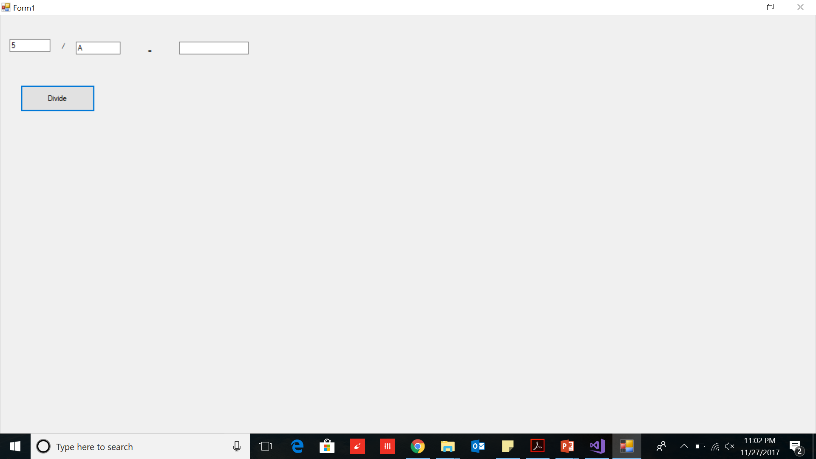
Runtime Errors Entering wrong format

Slide 11
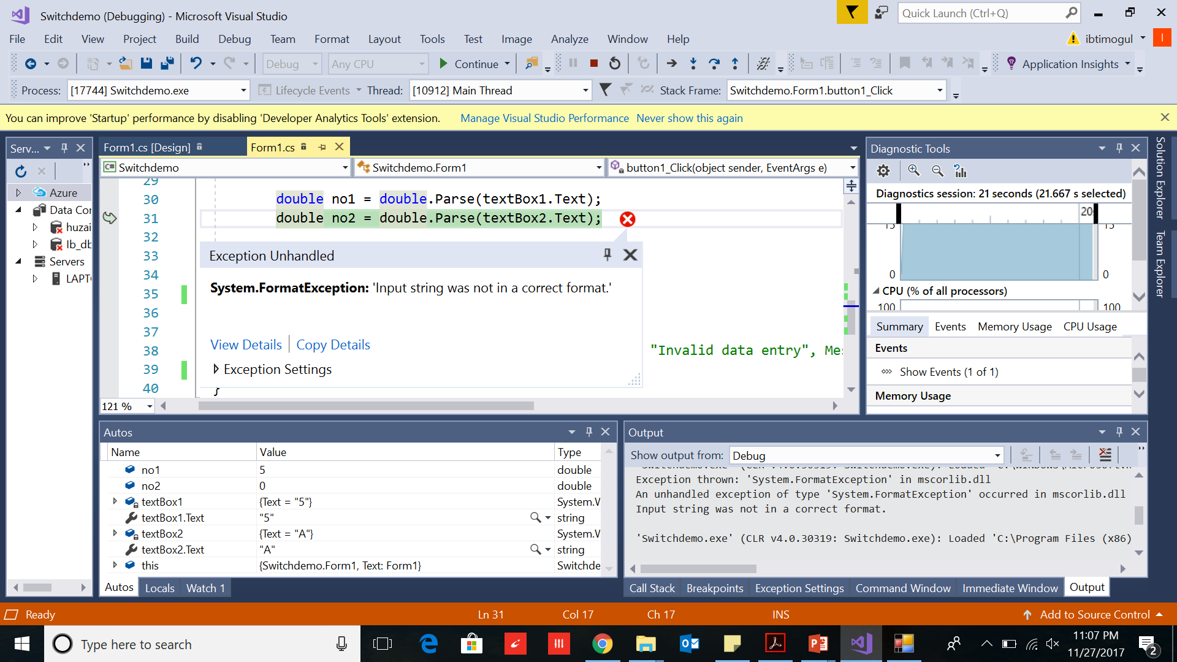
Runtime Error

Slide 12
private void button1_Click(object sender, EventArgs e)
{
double result;
double no1 = double.Parse(textBox1.Text);
double no2 = double.Parse(textBox2.Text);
result = no1 / no2;
textBox3.Text = result.ToString();
}
Exception thrown: 'System.FormatException’
An unhandled exception of type 'System.FormatException' occurred
Input string was not in a correct format.

Slide 13
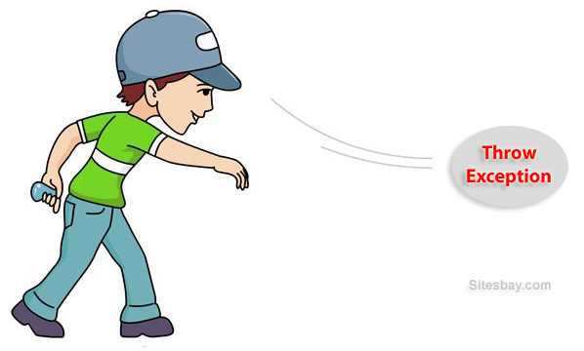
Exception
Exception
An exception is a condition that is caused by a
runtime error in the program.
an exception object is created and
throws it(informs user that an error occurred).
If exception object is not caught and handled then
interpreter will display an error message and
terminate program

Slide 14
Checkout your own Error
Run any of your program
Instead of integer(number)
Enter a character
Click Button
See the Runtime error

Slide 15
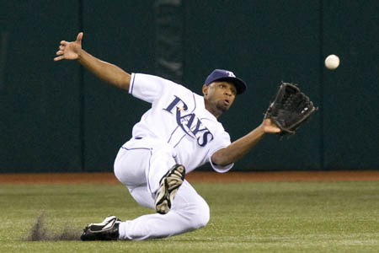
Exception Handling
To continue the program execution:
catch the exception object thrown
by the error condition and
display a message for corrective action or
perform corrective action .
This task is called
Exception Handling.

Slide 16
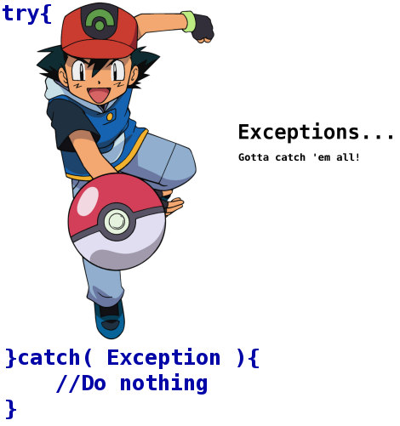
Motivation
We seek robust programs
When something unexpected occurs
Ensure program detects the problem
Then program must do something about it
(eg: Report and act)
Need mechanism to check for problem where it could occur
When condition does occur
Have control passed to code to handle the problem

Slide 17
Sr.No. | Exception | Description
1 | ArithmeticException | Arithmetic error, such as divide-by-zero.
2 | ArrayIndexOutOfBoundsException | Array index is out-of-bounds.
3 | ArrayStoreException | Assignment to an array element of an incompatible type.
4 | ClassCastException | Invalid cast.
5 | IllegalArgumentException | Illegal argument used to invoke a method.
6 | IndexOutOfBoundsException | Some type of index is out-of-bounds.
7 | NegativeArraySizeException | Array created with a negative size.
8 | NullPointerException | Invalid use of a null reference.
9 | NumberFormatException | Invalid conversion of a string to a numeric format.
10 | SecurityException | Attempt to violate security.
11 | StringIndexOutOfBounds | Attempt to index outside the bounds of a string.
12 | FileNotFoundException | Attempt to access a non-existent file
Sr.No. | Exception | Description
1 | ArithmeticException | Arithmetic error, such as divide-by-zero.
2 | ArrayIndexOutOfBoundsException | Array index is out-of-bounds.
3 | ArrayStoreException | Assignment to an array element of an incompatible type.
4 | ClassCastException | Invalid cast.
5 | IllegalArgumentException | Illegal argument used to invoke a method.
6 | IndexOutOfBoundsException | Some type of index is out-of-bounds.
7 | NegativeArraySizeException | Array created with a negative size.
8 | NullPointerException | Invalid use of a null reference.
9 | NumberFormatException | Invalid conversion of a string to a numeric format.
10 | SecurityException | Attempt to violate security.
11 | StringIndexOutOfBounds | Attempt to index outside the bounds of a string.
12 | FileNotFoundException | Attempt to access a non-existent file

Slide 18
System.Exception
Class Exception
is the base class of .NET’s exception class hierarchy.
In .NET, objects of class Exception and its derived classes may be thrown and caught.
A catch block that specifies a parameter of type Exception can catch all exceptions.

Slide 19
System.Exception Properties
Class Exception’s properties are used to formulate error messages indicating a caught exception.
Property Message stores the error message associated with an Exception object.
Property StackTrace contains a string that represents the method-call stack.
When an exception occurs, a programmer might use a different error message or indicate a new exception type.
The original exception object is stored in the InnerException property.
Other properties:
HelpLink specifies the location of a help file that describes the problem.
Source specifies the name of the application or object that caused the exception.
TargetSite specifies the method where the exception originated.

Slide 20
Types of Exceptions
System.Exception
System.ApplicationException
System.SystemException
System.AccessViolationException
System.ArgumentException
System.ArgumentNullException
System.ArgumentOutOfRangeException
System.FormatException
System.IndexOutOfRangeException
System.InvalidCastException
System.IO.IOException
System.IO.FileNotFoundException
System.NotImplementedException
System.NullReferenceException
System.OutOfMemoryException

Slide 21
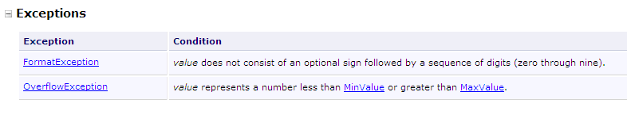
Determining Which Exceptions a FCL Method Throws
Example: Convert.ToInt32
Search for “Convert.ToInt32” in the Index of the Visual Studio
online documentation.
Select the document entitled Convert.ToInt32 Method.
In the document that describes the method, click the link
ToInt32(String).
The Exceptions section indicates that method Convert.ToInt32
throws two exception types.

Slide 22

Exception Handling Mechanism
Code that could generate errors, put those lines in try blocks
Code for error handling enclose in a catch clause
The finally clause always executes
Termination model of exception
handling
(The block in which the exception
occurs finishes)

Slide 23
Exception Handling Mechanism
Code that could generate errors, put those lines in try blocks
try
{
double result;
double no1 = double.Parse(textBox1.Text);
double no2 = double.Parse(textBox2.Text);
result = no1 / no2;
textBox3.Text = result.ToString();
}
Code for error handling enclose in a catch clause
The finally clause always executes

Slide 24
Exception Handling Mechanism
Code that could generate errors, put those lines in try blocks
try
{
double result;
double no1 = double.Parse(textBox1.Text);
double no2 = double.Parse(textBox2.Text);
result = no1 / no2;
textBox3.Text = result.ToString();
}
Code for error handling enclose in a catch block
catch (FormatException)
{
MessageBox.Show("Please enter correct format", "Invalid data entry", MessageBoxButtons.OK, MessageBoxIcon.Error);
}
The finally clause always executes

Slide 25
Exception Handler
Try block
Exception "thrown" here
Exception object creator statements
Catch block
Exception handler
Statements that handle exception matching the type it catches
If it fails to match then terminate

Slide 26
Catching Exceptions
try
{
statements; //Statements that may throw exceptions
}
catch (Exception1 exVar1)
{
handler for exception1;
}

Slide 27
try Block
try block
encloses code that might throw an exception +
the code that should not execute if an exception occurs
Consists of keyword try followed by a block of code enclosed in curly braces
Syntax:
try
{
}

Slide 28
Exception Handling
When an exception occurs:
try block terminates immediately
Program control transfers to matching catch block
try statement – consists of try block and corresponding catch and/or finally blocks

Slide 29
The finally Clause
try {
statements;
}
catch(TheException ex) {
handling ex;
}
finally {
finalStatements;
}

Slide 30
Trace a Program Execution No exception
animation
Suppose no exceptions in the statements
try {
statements;
}
catch(TheException ex) {
handling ex;
}
finally {
finalStatements;
}
Next statement;

Slide 31
Trace a Program Execution No exception
animation
The final block is always executed
try {
statements;
}
catch(TheException ex) {
handling ex;
}
finally {
finalStatements;
}
Next statement;

Slide 32
Trace a Program Execution No exception
animation
Next statement in the method is executed
try {
statements;
}
catch(Exception ex) {
handling ex;
}
finally {
finalStatements;
}
Next statement;

Slide 33
Trace a Program Execution Exception Occurred
animation
try {
statement1;
statement2;
statement3;
}
catch(Exception1 ex) {
handling ex;
}
finally {
finalStatements;
}
Next statement;
Suppose an exception of type Exception1 is thrown in statement2

Slide 34
Trace a Program Execution Exception Occurred
animation
try {
statement1;
statement2;
statement3;
}
catch(Exception1 ex) {
handling ex;
}
finally {
finalStatements;
}
Next statement;
The exception is handled.

Slide 35
Trace a Program Execution Exception Occurred
animation
try {
statement1;
statement2;
statement3;
}
catch(Exception1 ex) {
handling ex;
}
finally {
finalStatements;
}
Next statement;
The final block is always executed.

Slide 36
Trace a Program Execution Exception Occurred
animation
try {
statement1;
statement2;
statement3;
}
catch(Exception1 ex) {
handling ex;
}
finally {
finalStatements;
}
Next statement;
The next statement in the method is now executed.

Slide 37
Catch Runtime Errors
private void button1_Click(object sender, EventArgs e)
{
try
{
double result;
double no1 = double.Parse(textBox1.Text);
double no2 = double.Parse(textBox2.Text);
result = no1 / no2;
textBox3.Text = result.ToString();
}
catch (FormatException)
{
MessageBox.Show("Please enter correct format",
"Invalid data entry", MessageBoxButtons.OK, MessageBoxIcon.Error);
}
}

Slide 38
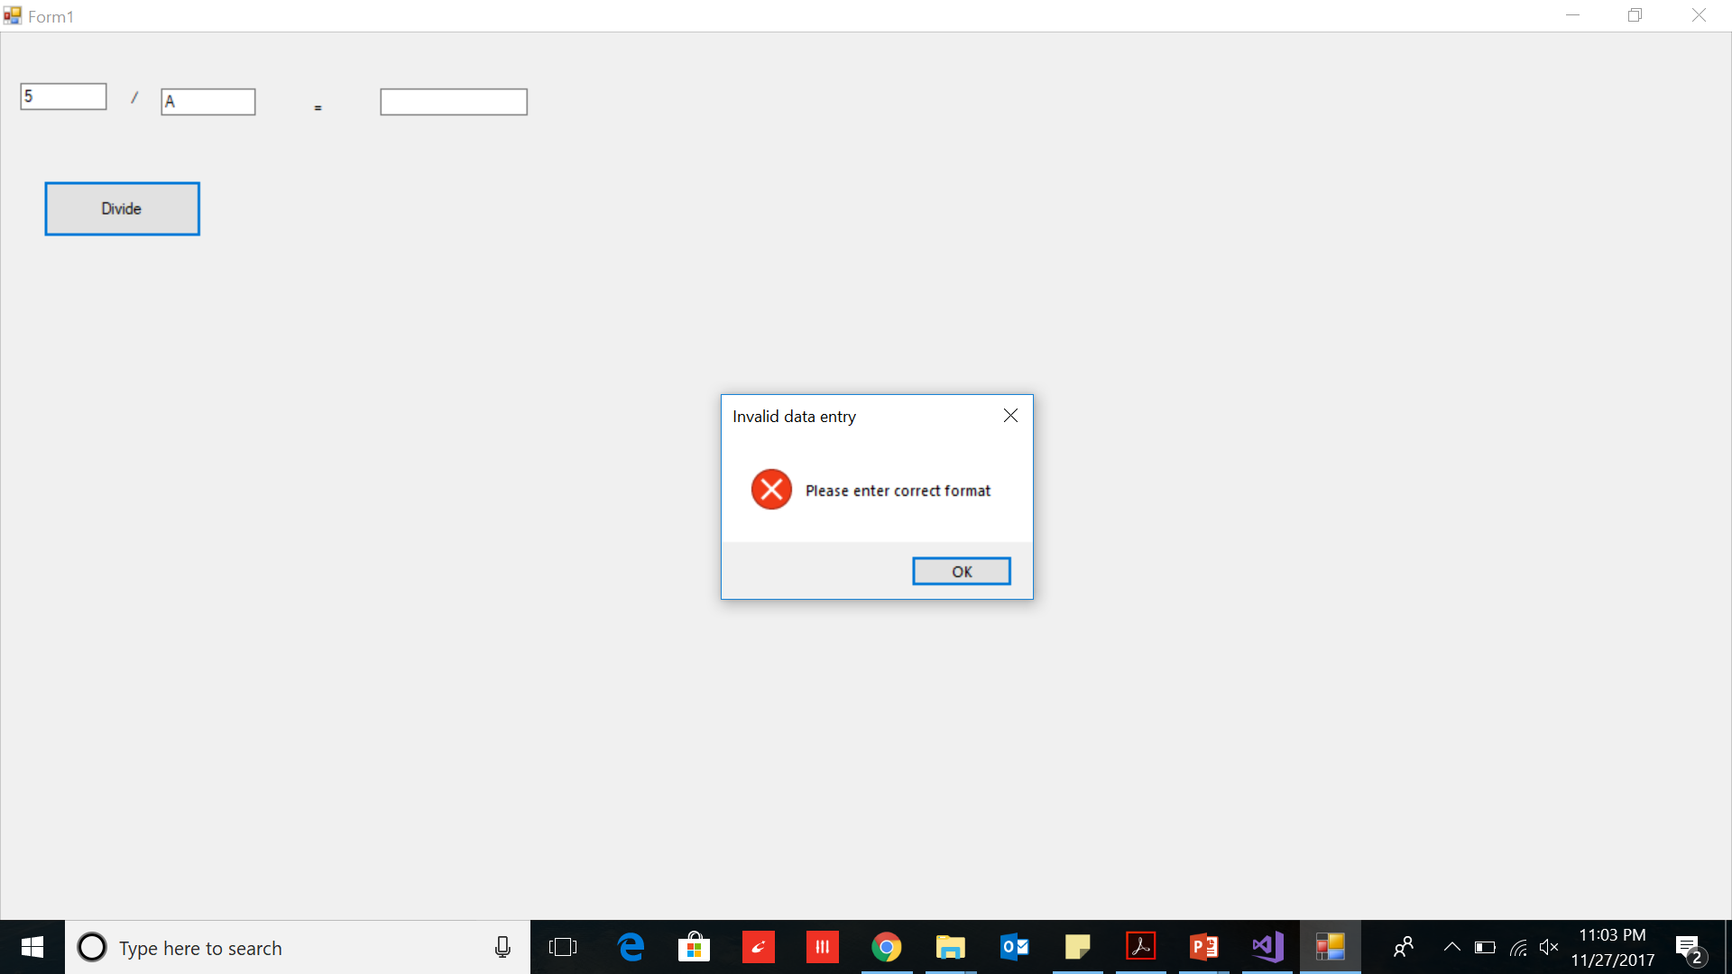

Slide 39
Activity
Perform for your Programs

